Slide 1



Depression Detection
Presentation by Tiham, Zain and Muhammad
Supervisor : Engr. Yasir Saleem Afridi
Final Year Project Presentation
Zain Ul Abideen 19PWCSE1796
Tiham Khan 19PWCSE1763
Muhammad 19PWCSE1763
Tiham Khan 19PWCSE1807
Zain Ul Abideen 19PWCSE1796
01
Muhammad 19PWCSE1763

Slide 2



Presentation by Tiham, Zain and Muhammad
Problem Statement
Detecting and understanding mental health issues, such as depression, is a critical task in today's digital era. With the widespread use of social media platforms like Twitter, there is an opportunity to analyze user-generated content, specifically tweets, to identify signs of depression. This project aims to develop a Python-based system that leverages sentiment analysis techniques to detect depression through the analysis of tweets.
02
Discussion Points

Slide 3

Presentation by Tiham, Zain and Muhammad
Data Collection and Preprocessing
Sentiment Analysis and Feature Extraction
We have Collected data from Twitter API where we used depressed related keywords to extract tweets on that basis and cleaned out links and signs so that only text is left
Sentiment Analysis did using Bert Pretrained Model and Roberta further Emotional analysis were done on the tweets to extract more features
Introduction
Model Development and Training
Evaluation and Performance Metrics
Model has been developed in such a way that all those tweets were considered as depressed whose sentiments and emotions were negative as well as the negative emotion intensity is greater then 80%.
Model was evaluated on the basis of validation graph where we noticed the logistic regression was overfitting meanwhile when we trained LSTM it was good fit for our dataset and the accuracy was near to 82%
03

Slide 4

Presentation by Tiham, Zain and Muhammad
Methodology
Tweets Extraction on the basis of keywords
Sentiment analysis on tweets
Emotion analysis
labeling depressed and non depressed on the basis of analysis
Model Training and Evaluation
Developing an MVP app
04

Slide 5
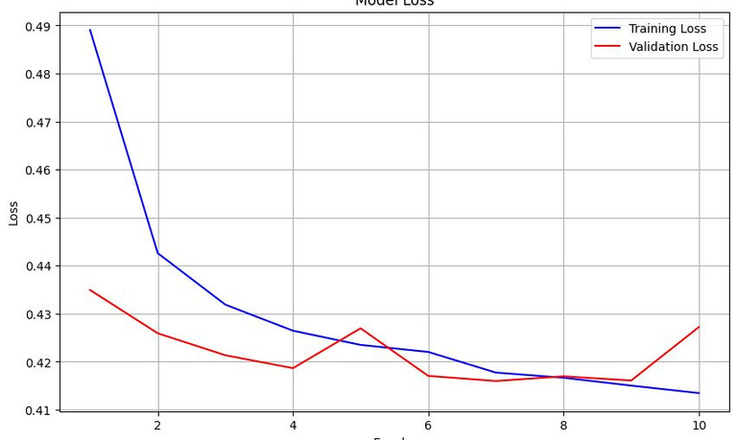
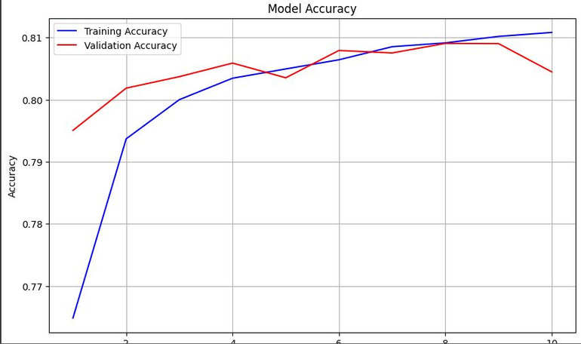
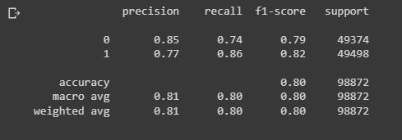
Presentation by Tiham, Zain and Muhammad
Results
At the end while training the model we have saw that logistic regression model was taking less time but it was
overfitting but then we used LSTM for training and the model accuracy came up to 77% also through learning curve we observed that model was good
fit for our dataset.
05

Slide 6
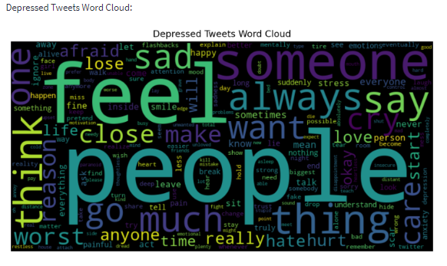
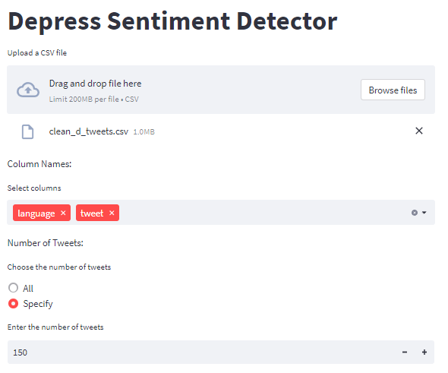
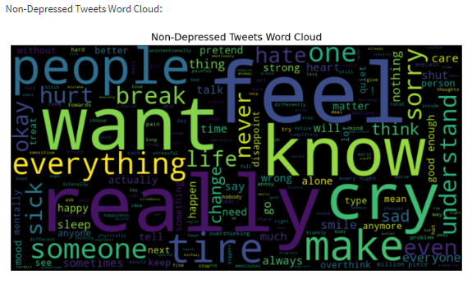
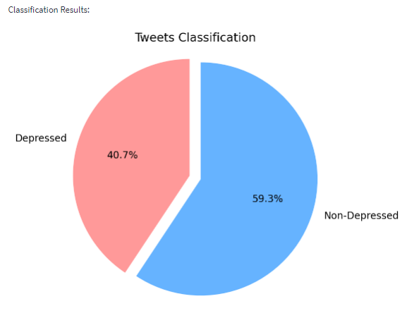
Presentation by Tiham, Zain and Muhammad
Application (MVP)
06
App Screenshots

Slide 7

Presentation by Tiham, Zain and Muhammad
Our Sources
Big data analytics on social networks for real-time depression detection
https://journalofbigdata.springeropen.com/articles/10.1186/s40537-022-00622-2
Deep Learning for Depression Detection of Twitter Users
https://journalofbigdata.springeropen.com/articles/10.1186/s40537-022-00622-2
Application of Sentiment Analysis to Language Learning
10.1109/ACCESS.2018.2832137
07

